Slide 1
Survival analysis and regression – Part 2
Michael Otterstatter
BCCDC Biostats Session
November 8, 2019

Slide 2
Session overview
In this session we will discuss
continue exploring regression models for survival data
an example of a Cox proportional hazards regression

Slide 3
Background
Simply put, ‘survival analysis’ is the analysis of longitudinal event data, specifically the time-to-event
Often, and historically, these analyses focussed on the survival, or time-to-death, of people
But, the same models apply to the time to injury, illness, admission, readmission, recovery, or any definable health or disease state, and even the time to failure of machines!

Slide 4

Survival analysis
Define event of interest, time zero, time scale and how participants exit
Consideration of censoring
Descriptive analysis: univariate modeling
KM curves and descriptive statistics
Inferential analysis: multivariate modeling
Cox regression (semi-parametric)

Slide 5
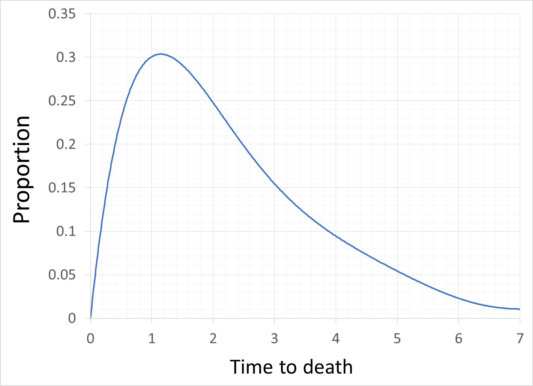
Concepts: Survival and hazard
Distribution of survival times
survival distribution, f(t)
Fraction dying
by time t, F(t)
Fraction surviving
by time t, S(t)

Slide 6
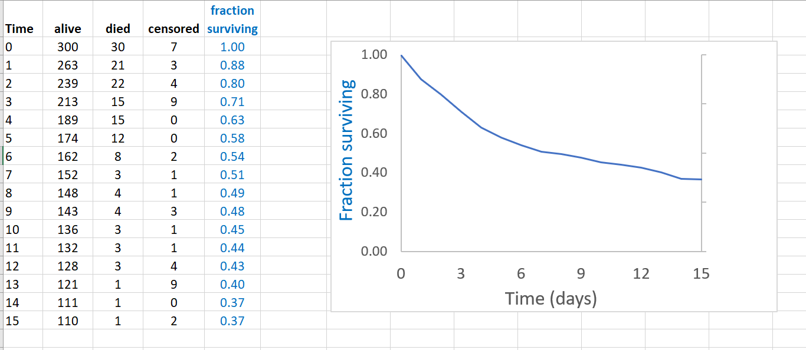
Concepts: Survival and hazard
Survival curve, S(t): Fraction (or probability of) surviving by time t
Fraction surviving
by time t, S(t)

Slide 7
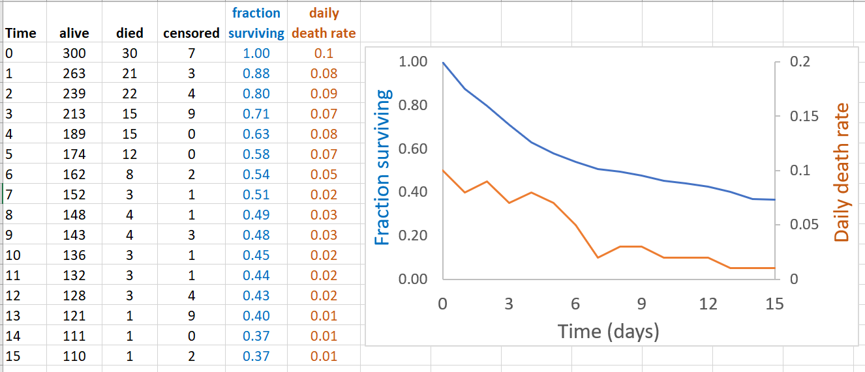
Concepts: Survival and hazard
Hazard h(t) : risk of death in the next small interval among those still alive
Fraction surviving
by time t, S(t)
Hazard, h(t)

Slide 8
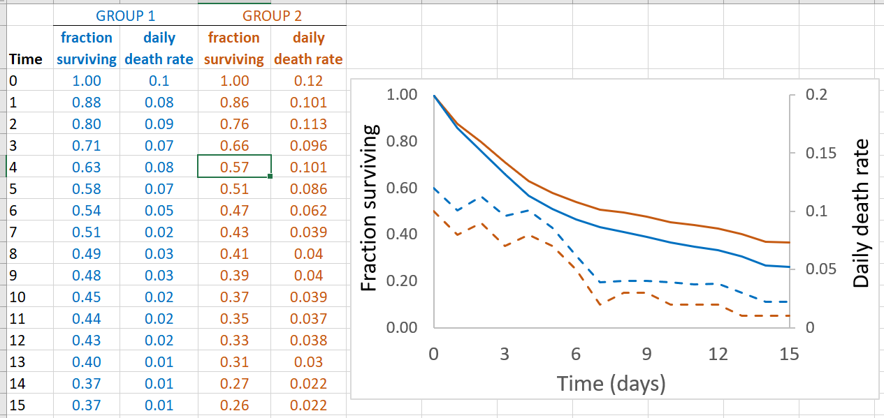
Concepts: Survival and hazard
Hazard ratio h₁(t) / h₂(t) : ratio of hazards between two groups
group 1 h₁(t)
group 2 h₂(t)

Slide 9
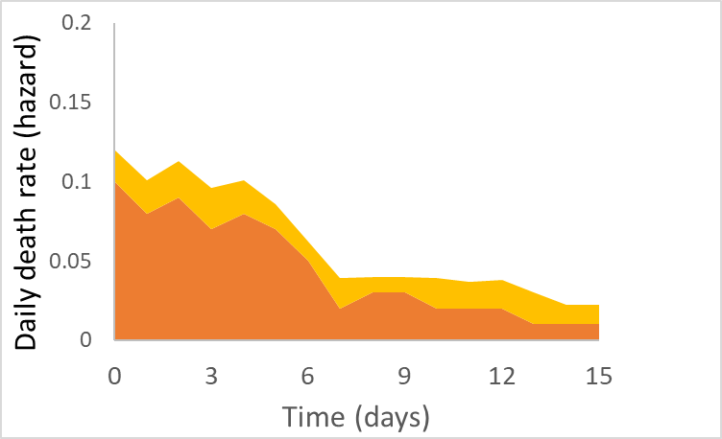
Concepts: Survival and hazard
If the hazards h₁(t) and h₂(t) remain proportional over time, the difference in risk can be properly summarized by a single number, the hazard ratio
group 1 h₁(t)
group 2 h₂(t)

Slide 10

Linear models: reminder
Recall, most regression models relate observations to a linear series of predictors, in the general form
$y= α+β_{1}x_{1}+β_{2}x_{2}…$

Slide 11
Linear models: reminder
Recall, most regression models relate observations to a linear series of predictors, in the general form
$y= α+β_{1}x_{1}+β_{2}x_{2}…$
intercept slopes

Slide 12
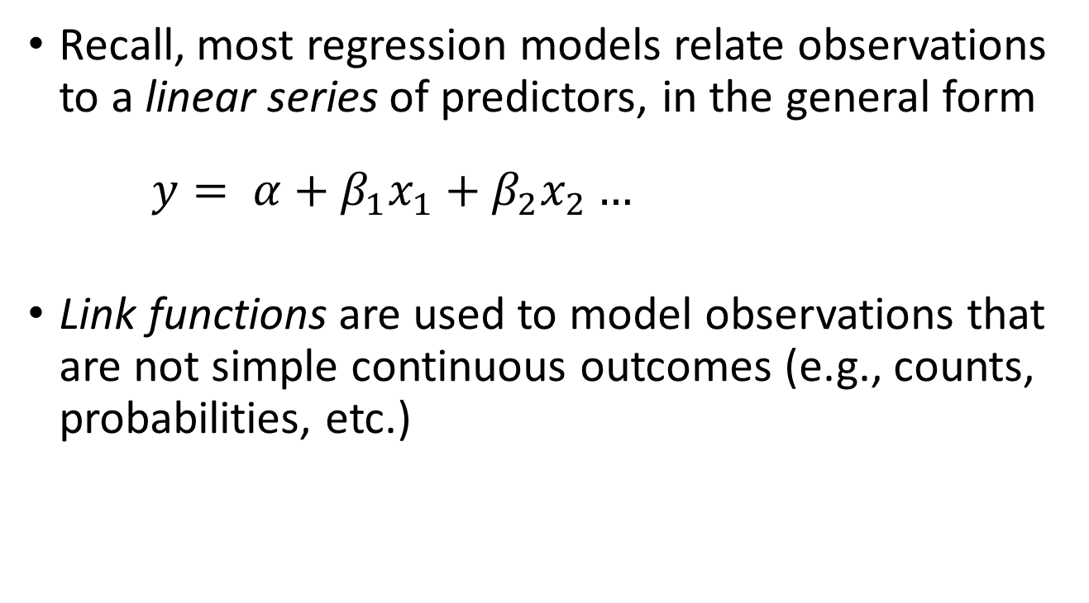
Linear models: reminder
Recall, most regression models relate observations to a linear series of predictors, in the general form
$y= α+β_{1}x_{1}+β_{2}x_{2}…$
Link functions are used to model observations that are not simple continuous outcomes (e.g., counts, probabilities, etc.)

Slide 13
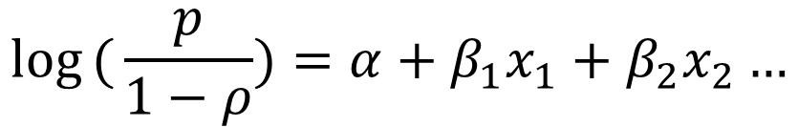
Linear models: reminder
Recall, most regression models relate observations to a linear series of predictors, in the general form
$y= α+β_{1}x_{1}+β_{2}x_{2}…$
Link functions are used to model observations that are not simple continuous outcomes (e.g., counts, probabilities, etc.)
$${log⁡(μ}_{i})= {α+β}_{1}x_{1}+β_{2}x_{2}…$$
Poisson model
Logistic model
$$log({\frac{p}{1−ρ})}=α+β_{1}x_{1}+β_{2}x_{2}…$$

Slide 14
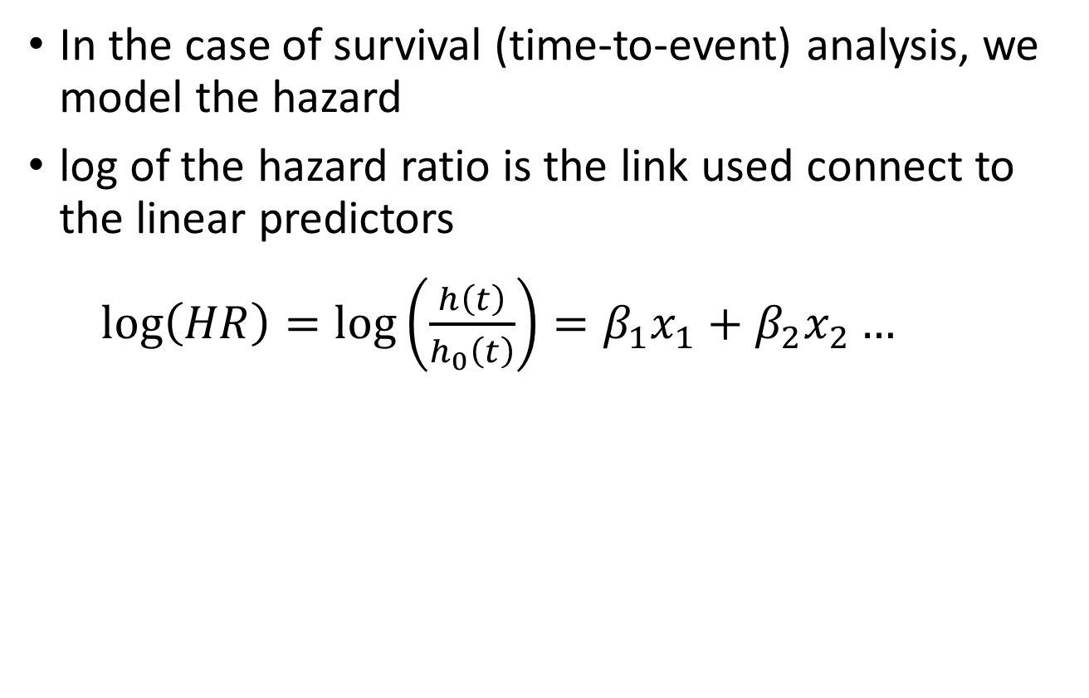
Proportional hazards models
In the case of survival (time-to-event) analysis, we model the hazard
log of the hazard ratio is the link used connect to the linear predictors
$\log\left(HR\right)=\log\left(\frac{h\left(t\right)}{h_{0}\left(t\right)}\right)=β_{1}x_{1}+β_{2}x_{2}…$

Slide 15
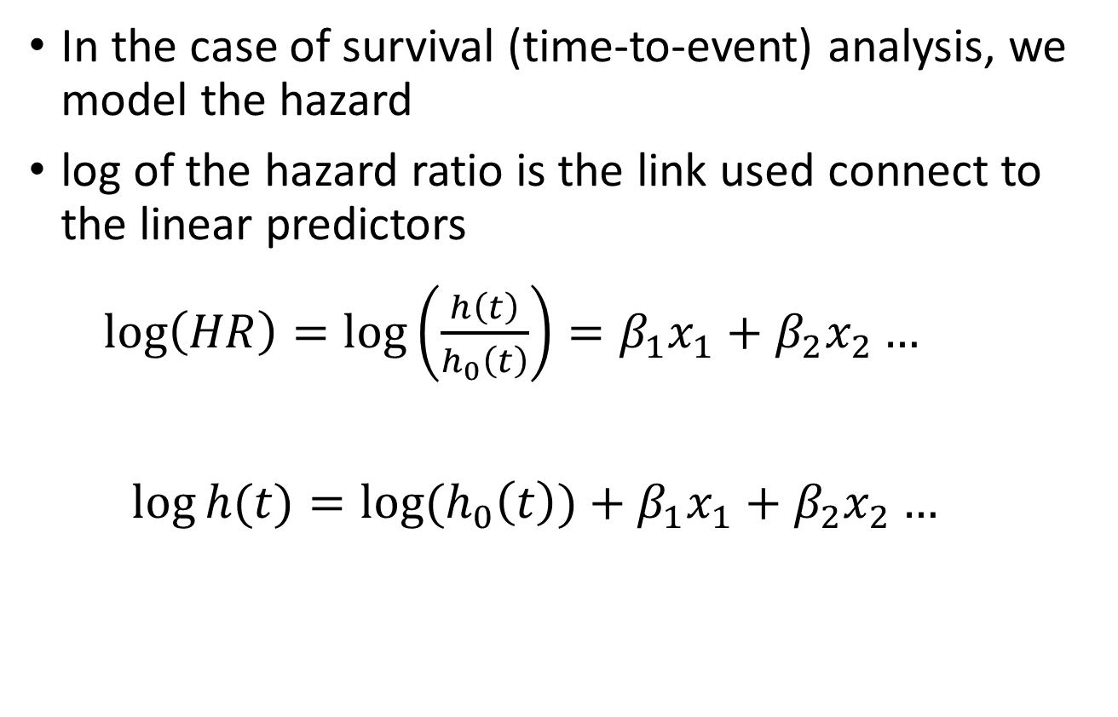
Proportional hazards models
In the case of survival (time-to-event) analysis, we model the hazard
log of the hazard ratio is the link used connect to the linear predictors
$\log\left(HR\right)=\log\left(\frac{h\left(t\right)}{h_{0}\left(t\right)}\right)=β_{1}x_{1}+β_{2}x_{2}…$
$$\log{h(t)}=log⁡(h_{0}\left(t\right){)+β}_{1}x_{1}+β_{2}x_{2}…$$
Intercept slopes

Slide 16
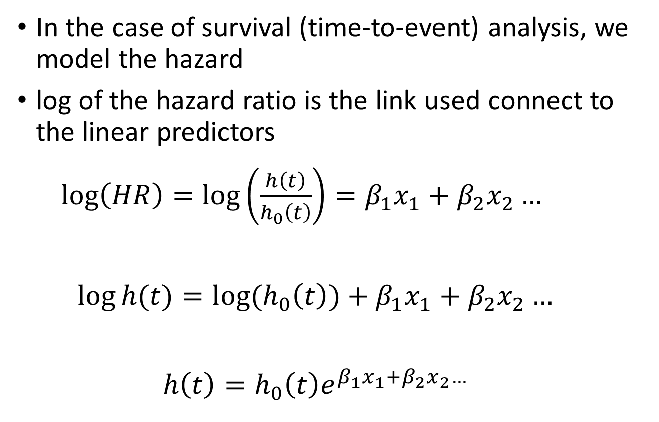
Proportional hazards models
In the case of survival (time-to-event) analysis, we model the hazard
log of the hazard ratio is the link used connect to the linear predictors
$\log\left(HR\right)=\log\left(\frac{h\left(t\right)}{h_{0}\left(t\right)}\right)=β_{1}x_{1}+β_{2}x_{2}…$
$$\log{h(t)}=log⁡(h_{0}\left(t\right){)+β}_{1}x_{1}+β_{2}x_{2}…$$
$$h\left(t\right)=h_{0}\left(t\right)e^{β_{1}x_{1}+β_{2}x_{2}…}$$

Slide 17
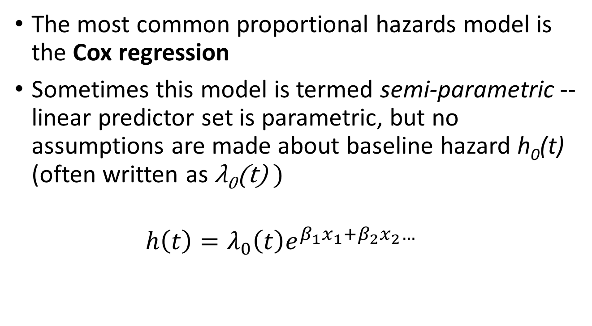
Proportional hazards models
The most common proportional hazards model is the Cox regression
Sometimes this model is termed semi-parametric -- linear predictor set is parametric, but no assumptions are made about baseline hazard h₀(t) (often written as λ₀(t) )
$$h\left(t\right)=λ_{0}\left(t\right)e^{β_{1}x_{1}+β_{2}x_{2}…}$$

Slide 18
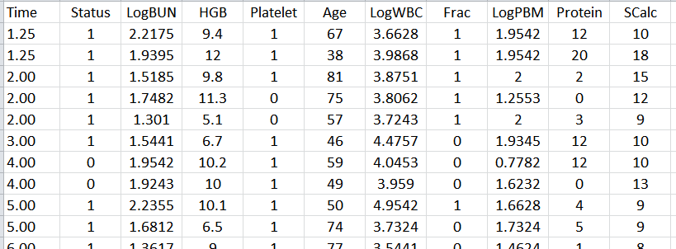
An example
Multiple myeloma study (see Krall et al, 1975)
65 patients undergoing treatment (48 died during study)
Analysis of survival time from diagnosis
Identifying factors associated with survival
Time (months)
White blood cells
Plasma cells in marrow
Serum calcium
Blood urea nitrogen
Hemoglobin
Protein in urine
Alive/Dead

Slide 19
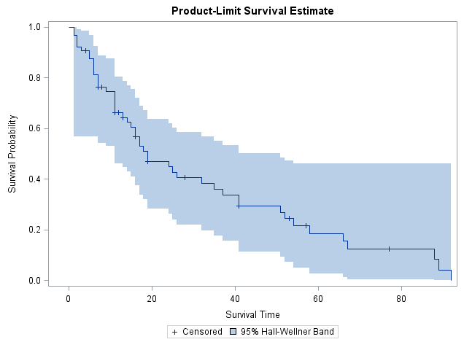
Descriptive analysis
Kaplan-Meier survival curve
Mean ± SD survival time:
32.1 ± 4.0 months from Dx

Slide 20
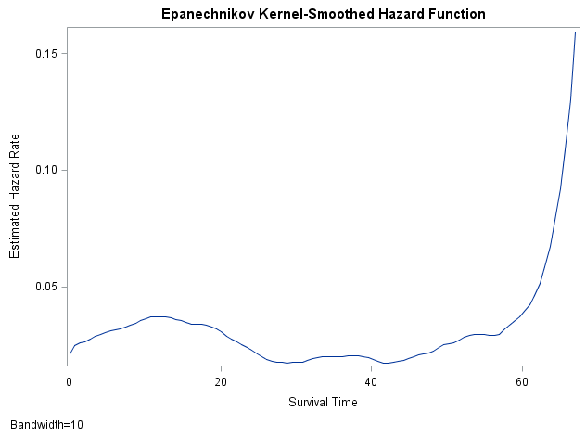
Descriptive analysis
Estimated (smoothed) hazard function

Slide 21
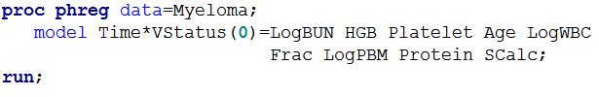

Inferential analysis
Cox proportional hazards regression
$$h\left(t\right)=λ_{0}\left(t\right)e^{β_{1}x_{1}+β_{2}x_{2}…}$$

Slide 22
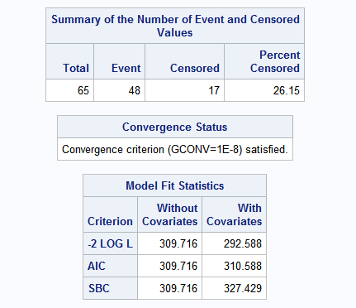
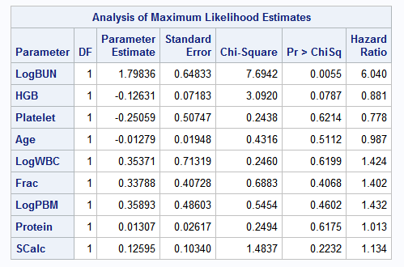
Inferential analysis
Cox proportional hazards regression
$$h\left(t\right)=λ_{0}\left(t\right)e^{β_{1}x_{1}+β_{2}x_{2}…}$$

Slide 23
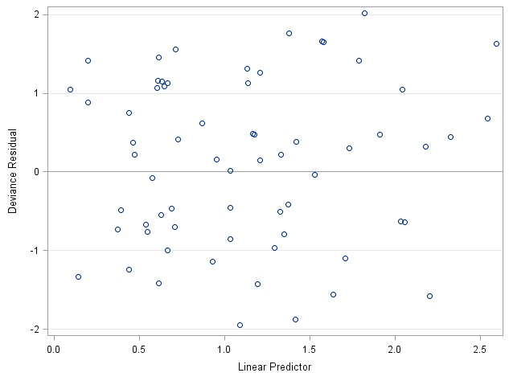
Inferential analysis
Assessing model fit (as usual, with residuals)

Slide 24
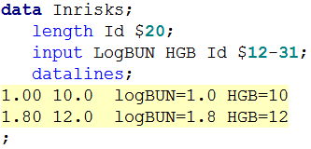

Inferential analysis
Estimating survival using fitted model
covariate values of interest

Slide 25
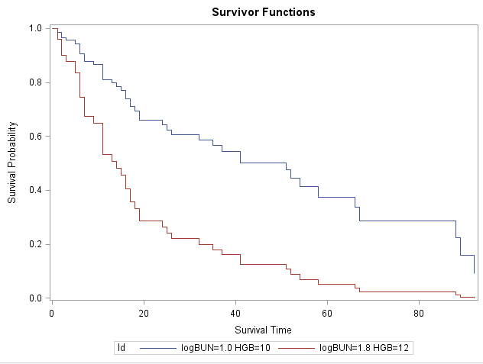
Inferential analysis
Estimating survival using fitted model

Slide 26
References
Columbia University Mailman School of Public Health. Population Health Methods. Time to event data analysis. https://www.mailman.columbia.edu/research/population-health-methods/time-event-data-analysis
George H. Dunteman & Moon-Ho R. Ho. 2011. Survival Analysis. In, An Introduction to Generalized Linear Models. SAGE Publications, Inc.
Krall, J. M., Uthoff, V. A., and Harley, J. B. 1975. A Step-up Procedure for Selecting Variables Associated with Survival. Biometrics 31: 49–57.
McCullagh P, Nelder JA. 1989. Generalized Linear Models. Chapman & Hall.
O'Quigley, J., 2008. Proportional hazards regression (Vol. 542). New York: Springer.
Sainani, K.L. Introduction to Survival Analysis. Stanford University Department of Health Research and Policy. https://web.stanford.edu/~kcobb/index.html

